Slide 1


Slide 2


Workshop on
Arduino Basics

Slide 3
What will you learn?
Microcontrollers and Microprocessors
What is arduino?
Arduino Board Description
Sensors
Arduino Code Language
Simulation
Major Project

Slide 4
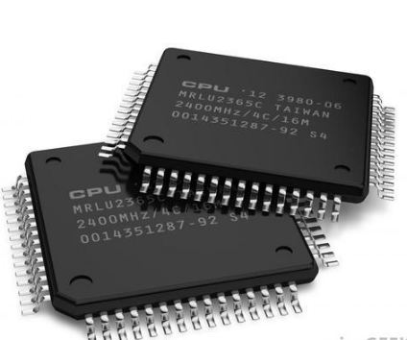
MICROPROCESSORS AND MICROCONTROLLERS
After going through this part, you will learn:
Types of Microcontrollers
Their differences
Applications
Specifications

Slide 5
Why do we need to learn Microprocessors/Controllers?
The microprocessor is the core of computer systems.
Nowadays many communication, digital entertainment, portable devices, are controlled by them.
A designer should know what types of components he needs, ways to reduce production costs and product reliable

Slide 6
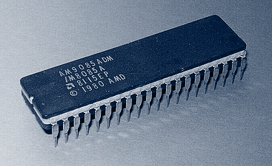
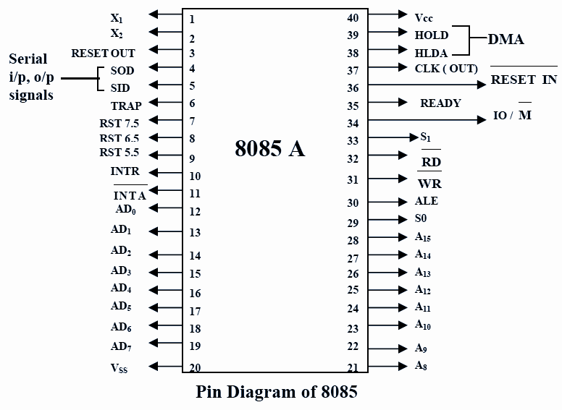
Introduction to Microprocessor!
A microprocessor simply consists of the processor, the ALU (Arithmetic Logic Unit), the Instruction Decoder and a few registers which are used to store data for mathematical and logical operations. Eg-8085, 8086

Slide 7
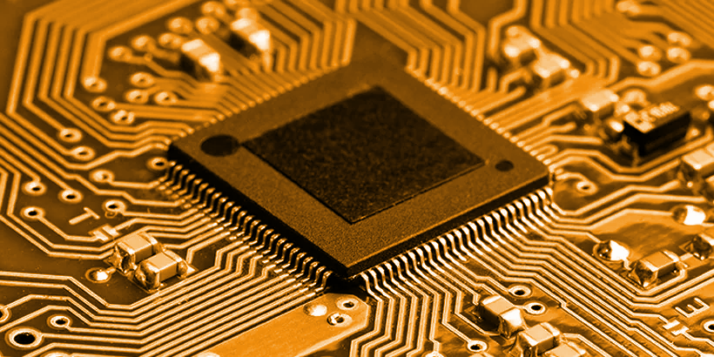
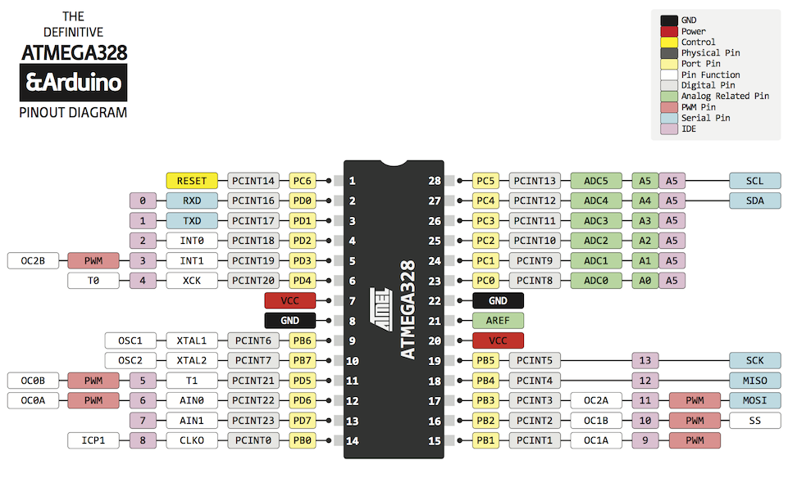
Introduction to Microcontrollers!
A microcontroller (MCU) is a small computer on a single integrated circuit consisting of a relatively simple central processing unit (CPU) combined with peripheral devices such as memories, I/O devices, and timers. – By some accounts, more than half of all CPUs sold worldwide are microcontrollers
The ATMega328p is the microcontroller used in the Arduino Uno and the Arduino is simply an interface to program the said microcontroller for use in embedded systems projects

Slide 8
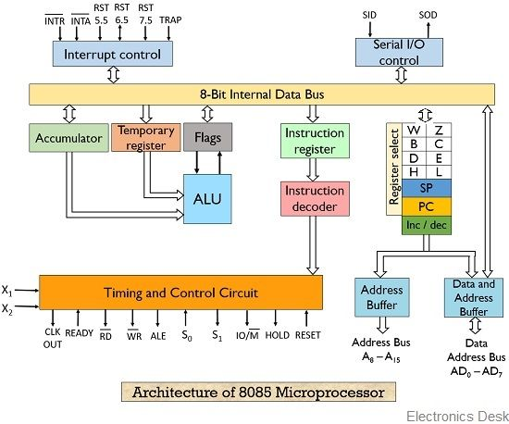
A microcontroller includes a processor, the ALU, Instruction Decoder, registers, code storage space(flash memory/ROM), RAM, general purpose I/O pins, timers, interrupt controller, serial communication module etc.
That is, the microcontroller is a microprocessor with some basic modules.

Slide 9
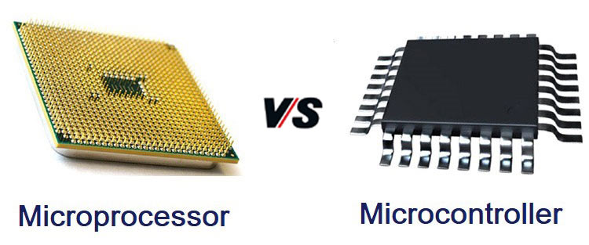

Slide 10
Microprocessor
Microcontroller
CPU is stand-alone, RAM, ROM, I/O, timer are separate
Designer can decide on the amount of ROM, RAM and I/O ports.
Expensive
General-purpose
CPU, RAM, ROM, I/O and timer are all on a single chip.
Fix amount of on-chip ROM, RAM, I/O ports
For applications in which cost, power and space are critical
Single-purpose

Slide 11
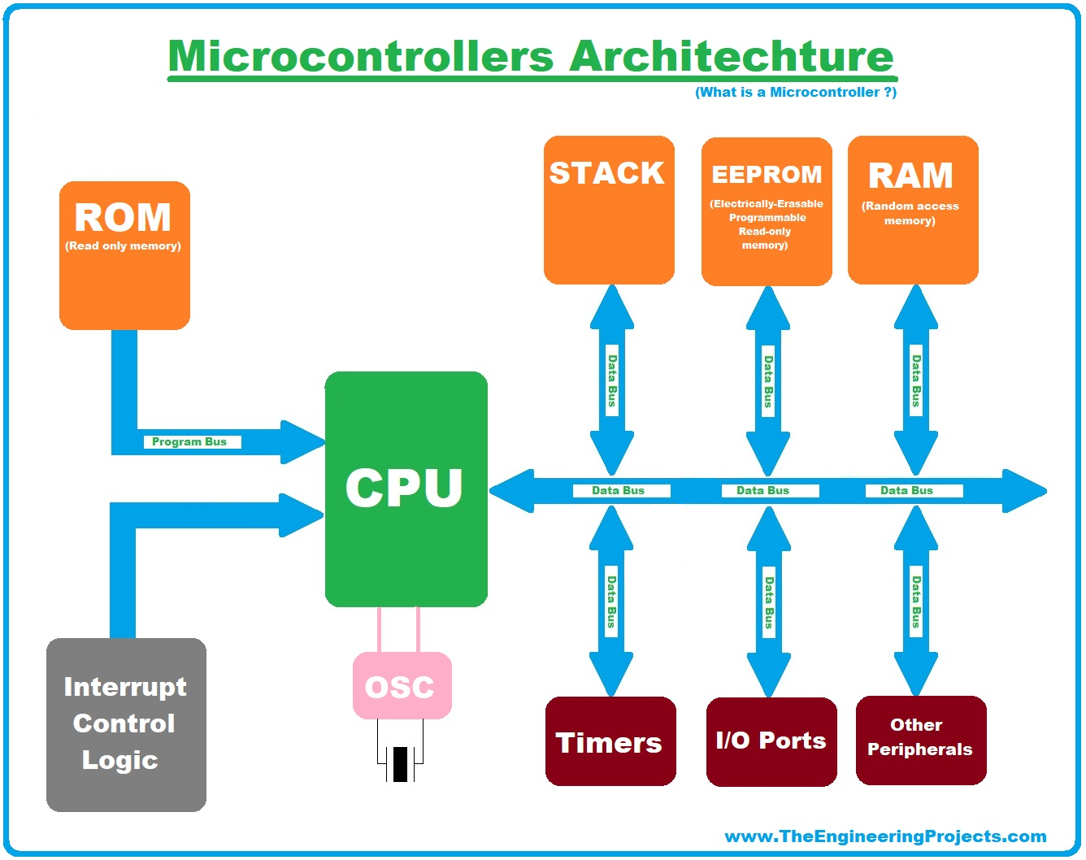
The necessary tools for a microprocessor/controller
CPU: Central Processing Unit
I/O: Input /Output
Bus: Address bus & Data bus
Memory: RAM & ROM
Timer
Interrupt
Serial Port
Parallel Port

Slide 12

What is arduino ?
After going through this part, you will learn :
The Introduction to Arduino (Microcontroller)
Their types
Real Life Applications

Slide 13
Introduction to Arduino
The Arduino is an open-source electronics platform based on easy-to-use hardware and software used to build electronics projects.
You can tell your board what to do by sending a set of instructions to the microcontroller on the board.

Slide 14
Introduction to Arduino
All Arduino boards have one thing in common which is a microcontroller.
An Arduino is based on a microcontroller which is a simple easy to use computer designed for beginners to run 1 program at a time.

Slide 15
WHY TO USE ARDUINO ?
Arduino simplifies microcontrollers for beginners
Cheap
Cross-Platform
Wide Variety
Jupiter is the biggest one
Mercury is the smallest planet

Slide 16
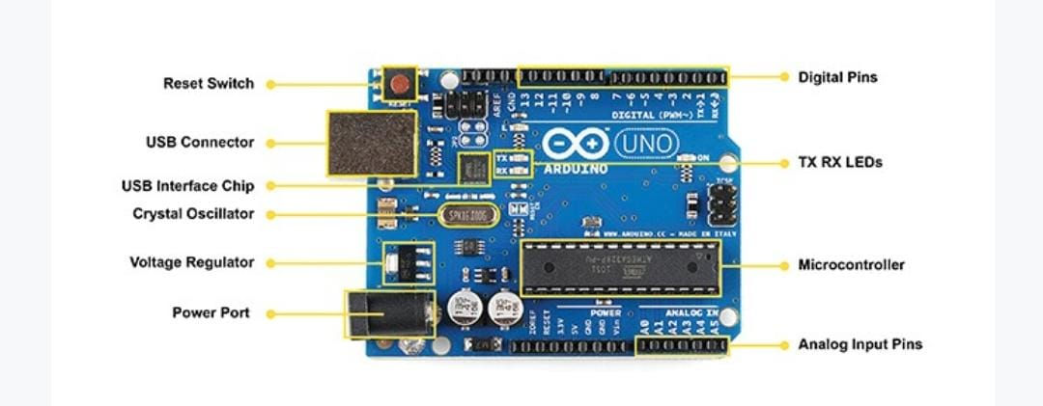
TYPES OF ARDUINO
Arduino Uno
Arduino UNO is based on an ATmega328P microcontroller.
The Arduino UNO includes 6 analog pin inputs, 14 digital pins, a USB connector, a power jack, and an ICSP (In-Circuit Serial Programming) header.
It is recommended for beginners as it is easy to use.

Slide 17
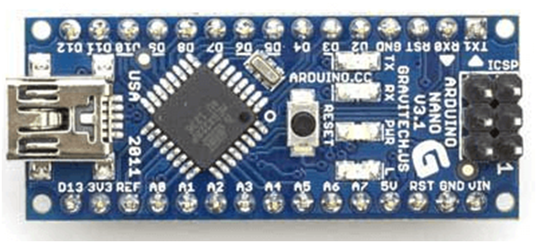
ARDUINO NANO
The Arduino Nano is a small Arduino board based on ATmega328 or ATmega628 Microcontroller. The connectivity is the same as the Arduino UNO board.
The Arduino Nano includes an I/O pin set of 14 digital pins and 8 analog pins. It also includes 6 Power pins and 2 Reset pins.

Slide 18
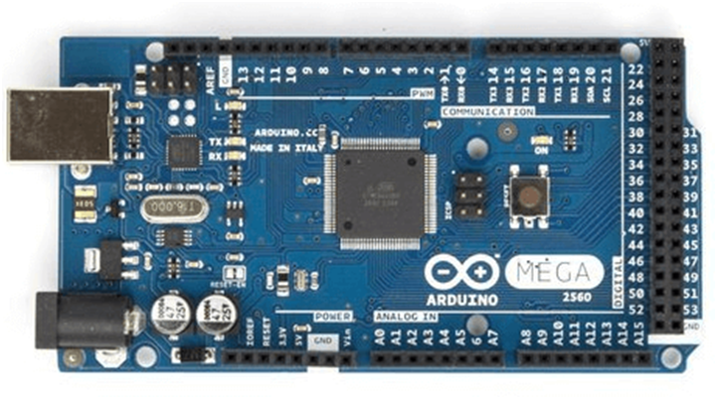
Arduino Mega
The Arduino Mega is based on ATmega2560 Microcontroller. The ATmega2560 is an 8-bit microcontroller.
It has the advantage of working with more memory space.
The Arduino Mega includes 54 I/O digital pins and 16 Analog Input/Output (I/O), ICSP(In-Circuit Serial Programming) header, a reset button, 4 UART (Universal Asynchronous Reciever/Transmitter) ports, USB connection, and a power jack.

Slide 19
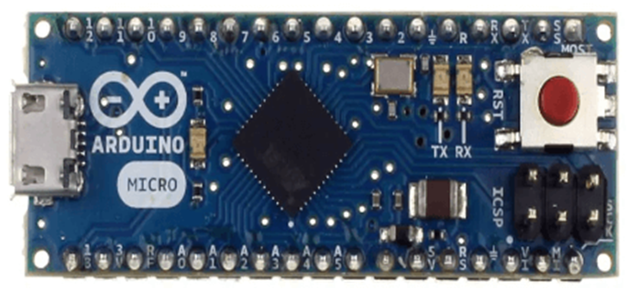
The Arduino Micro is based on the ATmega32U4 Microcontroller.
It consists of 20 sets of pins. The 7 pins from the set are PWM (Pulse Width Modulation) pins, while 12 pins are analog input pins. The other components on board are reset button,16MHz crystal oscillator, ICSP header, and a micro USB connection.
Arduino Micro

Slide 20
ABOUT THE ARDUINO IDE
After knowing the hardware of Arduino, you will require software and programming to make your Arduino come to life and allow it to interact with various sensors and shields.
To program your Arduino, you will require the Arduino IDE software.

Slide 21
This software can be used with any Arduino board like our Arduino Nano, Arduino UNO, etc. The environment is written in Java and based on processing and other open-source software.
This program uses a simplified version of C with syntax highlighting and other features which makes it easier to learn to program which is perfect for beginners to learn programming and coding!
Arduino IDE software

Slide 22
APPLICATION OF ARDUINO
Weighing Machines
Traffic Light Countdown Timer
Parking Lot Counter
Embedded systems
Home Automation
Industrial Automation
Medical Instrument
Emergency Light for Railways
The Arduino boards can work as a stand-alone project and can be interfaced with other Arduino boards or Raspberry Pi boards. Arduino UNO board is used in the following applications:

Slide 23
Arduino Board Description

Slide 24
EVERY ARDUINO BOARD Contains
Microcontroller – Act as the Brain of the Arduino board. Arduino generally uses the ATmega microcontroller produced by ATMEL.
INPUT/OUTPUT ports – Used to connect external input and output devices using jumper wires.
I/O ports are of 2 types :-
Digital pins – Its binary i.e. either HIGH or LOW. Any digital pin can be used as input or output pins.
Analog pins – These are used to take analog inputs.

Slide 25
5. USB Port - Used to upload the programs from IDE to the board and can be used to power up the board.
6.Voltage Regulator – Regulates the amount of voltage supplied to the microcontroller.
7.Reset Button – When clicked restarts the whole program that is being uploaded to the board.
3. TX/RX LEDs – Blinks when the board is receiving or transmitting signals.
4. Power Pins – The Vin, 5V, 3.3V, and GND pins are Arduino power pins. Both 5V and 3.3V pins can be used to provide power to the modules that are connected to the board. Vin can be used to power up the Arduino board. GND is the ground pin ,used to ground the circuit.
5.Crystal Oscillator - It helps arduino in dealing with time issues.

Slide 26
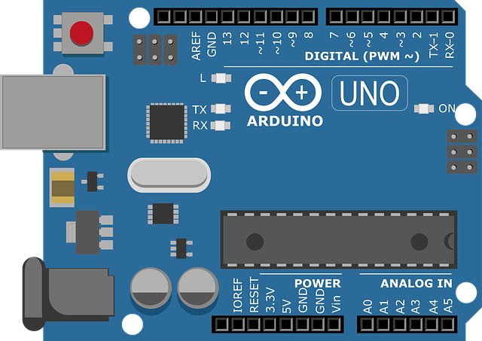
UNO Specific
Microcontroller – The Arduino uno uses ATmega328P as the microcontroller.
Digital pins – Arduino uno has 14 digital pins among which 6 pins are pwm pins.
Analog pins – There are 6 analog pins(A0-A5). These pins can read the signals from an analog sensor and convert it into a digital value.
Power pins – 3.3V, 5V,GND,Vin these are the power pins.
Power port – Arduino uno can be powered up via power port using a battery or an AC to DC adaptor.
Crystal Oscillator - It helps arduino in dealing with time issues.
USB port.
Voltage regulator.
TX/RX LEDs.
Reset button.

Slide 27
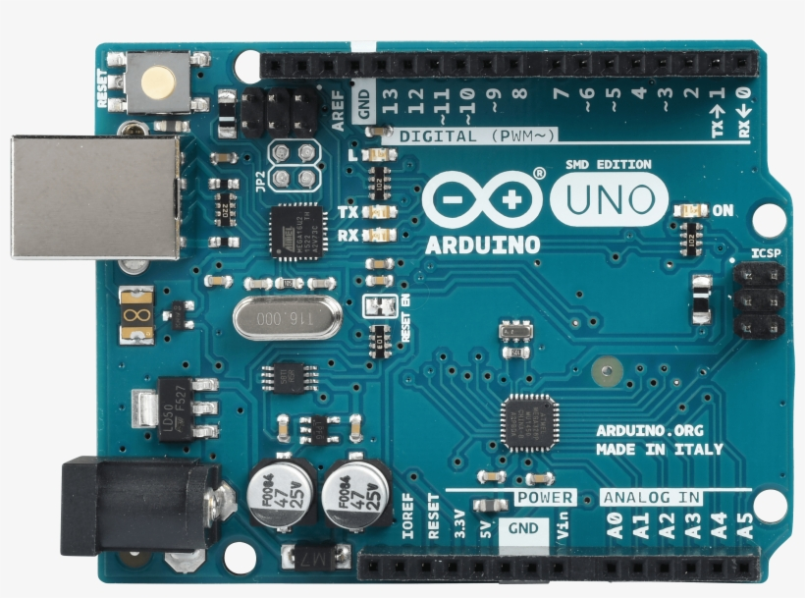
Specifications:
Microcontroller: ATmega328P
Operating Voltage: 5V
Input Voltage (recommended): 7-12V
Input Voltage (limit): 6-20V
Digital I/O Pins: 14 (of which 6 provide PWM output)
Analog Input Pins: 6
DC Current per I/O Pin: 20 mA
DC current for 3.3V Pin: 50 mA
Flash Memory: 32 KB
SRAM: 2 KB
EEPROM: 1 KB
Clock Speed: 16 MHz

Slide 28
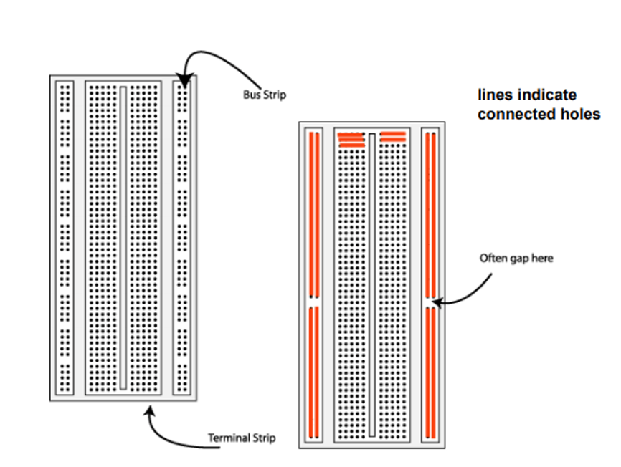
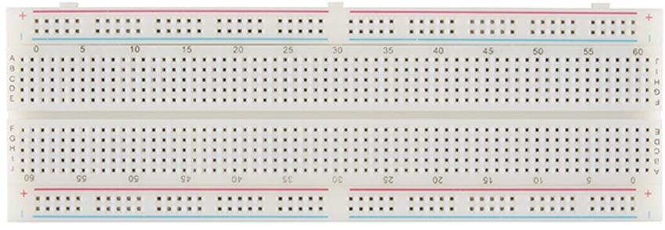
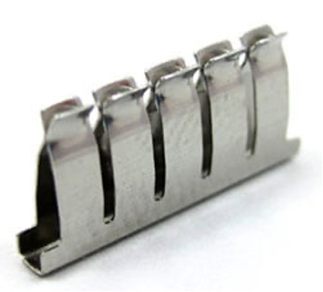
Breadboard
Breadboards are meant to make quick non-permanent connections between electronic components and they are covered with tiny socket holes which are connected in rows.
Metal clips:

Slide 29
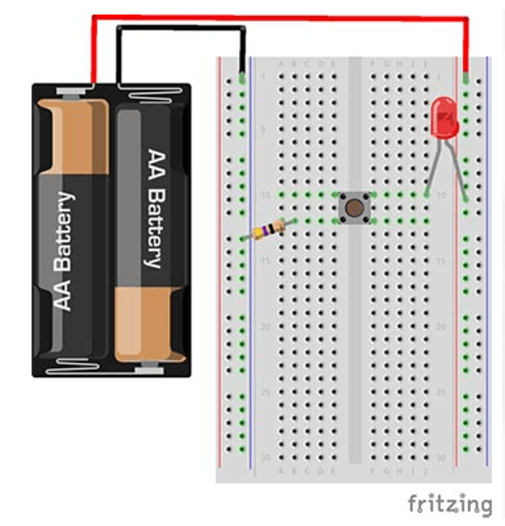
How to power a breadboard?
Powering a breadboard through Arduino:
Since the Arduino already gets its power from a computer or external power supply, you can simply power a breadboard from “borrowing” its power supply.
Here’s how to power your breadboard through Arduino:
Connect Arduino GND pin with female headers to the breadboard power rails
Red wire from the header to the breadboard (+) power rail
Black wire from the Arduino GND to the breadboard (-) power rail
Connecting a battery:

Slide 30
SENSORS

Slide 31
What are Sensors?
The sensors are defined as a machine, module, or a device that detect changes in the environment.
The sensors transfer those changes to the electronic devices in the form of a signal.
The output signal is easily readable by humans. The sensors are used to measure the physical quantities, such as pressure, temperature, sound, humidity, and light, etc.

Slide 32
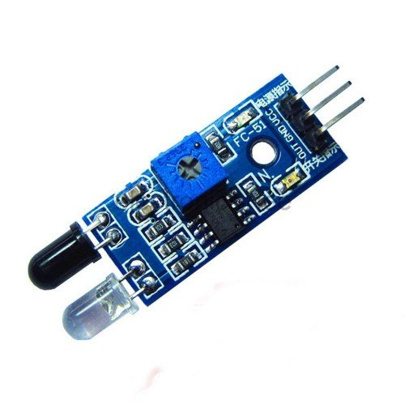
The Infrared (IR) Sensor
The infrared sensor uses two bulbs for detection of obstacles, namely, the transmitter bulb and receiver bulb. The transmitter bulb emits a pulse of infrared wavelength and the receiver gives positive output if it gets back an IR wave.

Slide 33
APPLICATIONS:
● Obstacle Detection: The IR sensors can be used to detect obstacles.
● Heat Detection: The IR sensors also give a positive output when subjected to heat.
LIMITATIONS:
IR Sensors cannot work under sunlight as sunlight has IR radiation and would render the sensor useless as it would continuously generate positive output.

Slide 34
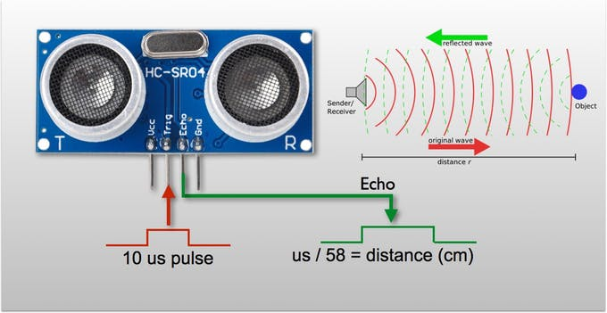
Ultrasonic Sensor (HC-SR04):
It is an ultrasonic sensor based on a transmitter and receiver and mainly used to determine the distance from the target object. The amount of time it takes to send and receive waves will determine how far the object is placed from the sensor.

Slide 35
APPLICATIONS:
Distance Detection: The ultrasonic sensor is used for the determination of distance between the sensor and obstacle.
LIMITATIONS:
Cannot work in a vacuum.

Slide 36
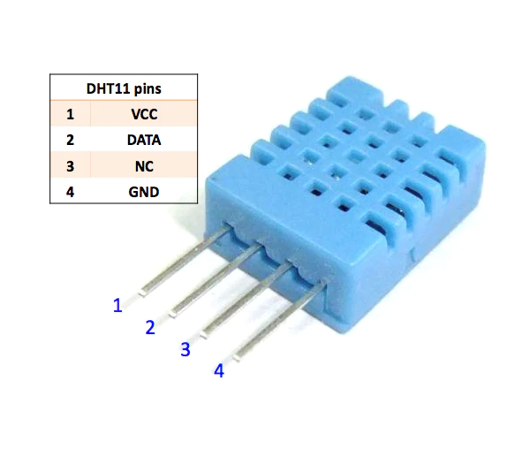
Temperature and Humidity Sensor (DHT11)
The DHT11 is a basic digital temperature and humidity sensor. It uses a capacitive humidity sensor and a thermistor to measure the surrounding air, and spits out a digital signal on the data pin (no analog input pins needed). It’s fairly simple to use, but requires careful timing to grab data.

Slide 37
APPLICATIONS:
● In designing Temp. and Humidity level-based alarms.
● IOT projects based on temperature or humidity levels.
LIMITATIONS:
The only real downside of this sensor is you can only get new data from it once every 2 seconds, so sensor readings can be up to 2 seconds old.

Slide 38
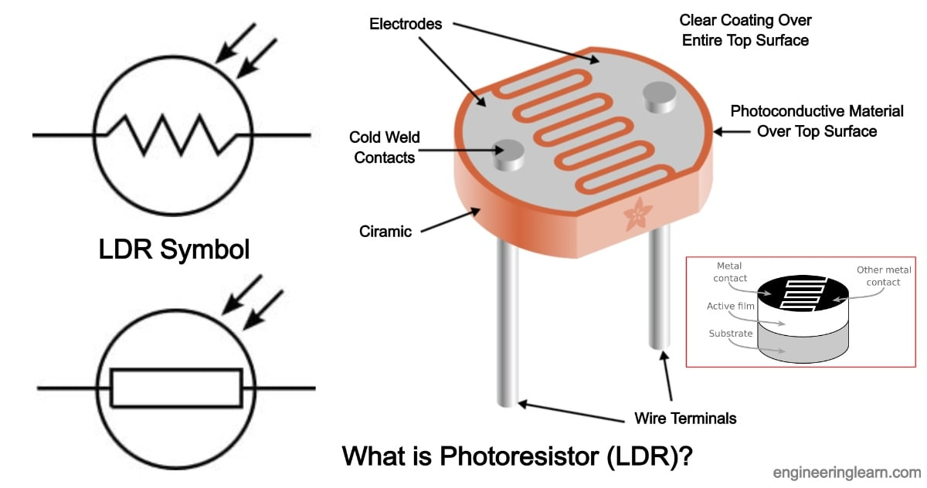
Light Dependent Resistor (LDR)
A Light Dependent Resistor (LDR) is also called a photoresistor, cadmium sulfide (CdS) cell or a photoconductor. It is a photocell that works on the principle of photoconductivity. The passive component is basically a resistor whose resistance value decreases when the intensity of light increases. This optoelectronic device is mostly used in light varying sensor circuit, and light and dark activated switching circuits.

Slide 39
APPLICATIONS:
● Automatic Street Light Circuit
● Simple Fire Alarm Circuit
● Light Activated Switch Circuit
● Automatic LED Emergency Light
● Night Security Light

Slide 40
ARDUINO CODE LANGUAGE

Slide 41
What is the use of Arduino Code Language?
Using Arduino Code Language, we make a set of instructions. We define in there what actions the Arduino would perform when a certain input is detected.
You have studied about pins in above sections. With the Arduino Code Language we can define how do we want to use which pin i.e. for input or for output.

Slide 42
Topics to be covered
Variables & Data Types
Operators
Flow Control
Loops
Functions
Code Structure
Arduino Functions

Slide 43
Variable & Data Types
Variables:
A variable is a way of naming and storing a value for later use. As their name suggest, they can be varied/changed continually.
A variable needs to be declared and sometime assigned to the value needing to be stored.
The following declares and assigns a value to a variable.
int input Variable = 0;
Type
Name
Value

Slide 44
DATA TYPES:
byte - It stores an 8-bit numerical value without any decimal point. It has a range of 0-255.
int - Integers are the primary data types used for storing numeric values without decimals. Range - -32,768 to 32,767 They take up a size of 16-bit or 2 bytes.
long - Extended size data type for integers. They take up to 32-bit and have a range of -2,147,483,648 to 2,147,583,648
float - Data type for holding numerical values with decimals. It has a range of -3.4028235E+38 to 3.4028235E+38

Slide 45
int myArray[] = {value1, value2, …..};
int myArray[5]; //declares an array with 6 positions.
myArray[3] = 10; //assigns the 4th value to 10
To retrieve a value from an array
x = myArray[3]; //x must be already declared as int. x becomes 10.
array - An array is a collection of values that can be accessed with index numbers. Basically you can think of them as a numbered list. There index number starts from 0. Array can hold the values of all data types above.
There are a couple of ways an array can be declared:

Slide 46
Operators
Arithmetic Operators: +, -, *, /
As the name suggest, they perform arithmetic operations i.e. Addition, Subtraction, Multiplication and Division.
They must be performed on the same type of variable and the result is in same type too.
For eg :
int x = 9;
int y = 4;
int z;
z = x/y; // In this case the result will be 2.25 but the value of z will become 2, because z is an integer.

Slide 47
Compound Assignments:
They are the combination of operators.
x++; //same as x = x+1;
x- -; //same as x = x-1;
x += y; //same as x = x+y;
Comparison Operators;
x == y; //will be true if x is equal to y
x != y; //will be true if x is not equal to y
x < y; //x is less than y
x > y; //x is greater than y
x <= y; //x is less than or equal to y
x >= y; //x is greater than or equal to y

Slide 48
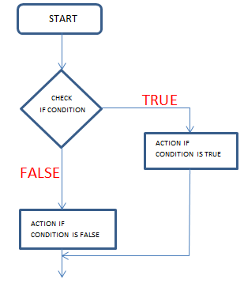
Flow Control
They are also called conditional statements.
They are used to perform certain actions if the required condition is fulfilled.
In this way, they maintain the flow in our code. Following are the conditional statements:
if, if else, switch case

Slide 49
if statement:
It surrounds a code and then executes that code if the condition required is fulfilled.
if (condition) {
//do something
}
if else statement:
If the condition comes out be false, the code inside else block will be executed.
if (condition) {
//will be executed if condition is true
} else {
//will be executed if condition is false
}

Slide 50
switch case:
In this statement, we write a variable with the switch and then we write selected values with cases. The code inside case block is executed when the variable is equal to the selected value of that case.
int x = 5;
switch (x) {
case 1:
//do something
break;
.
.
case 5:
//This code will be executed in this case.
break;
default:
//will be executed if none of the cases match

Slide 51
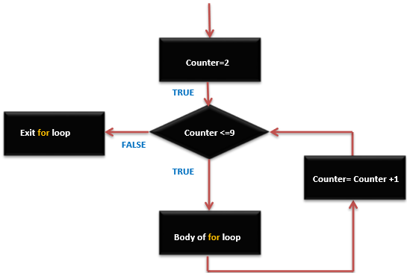
Loops
Loops are used when we need to repeatedly execute certain code for a desired number of times or till a requirement is satisfied.
for loop:
It is used to repeat a block of statements(code to be executed) a specific number of times. An increment counter is used.
for (initialization; condition; expression) {
//do something
}
for (int i =0; i<10; i++) {
//this code will be executed 10 times
}

Slide 52
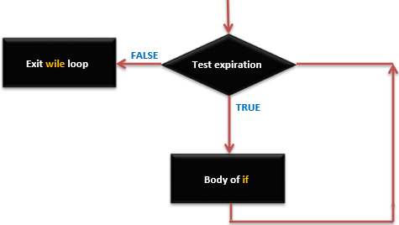
while loop:
It is used to execute a block of code until a required condition is satisfied.
while (condition) {
//this code will be executed till the condition becomes false
}
int i = 0;
while ( i <10) {
//this code will be executed till i becomes 10
I++;
}

Slide 53
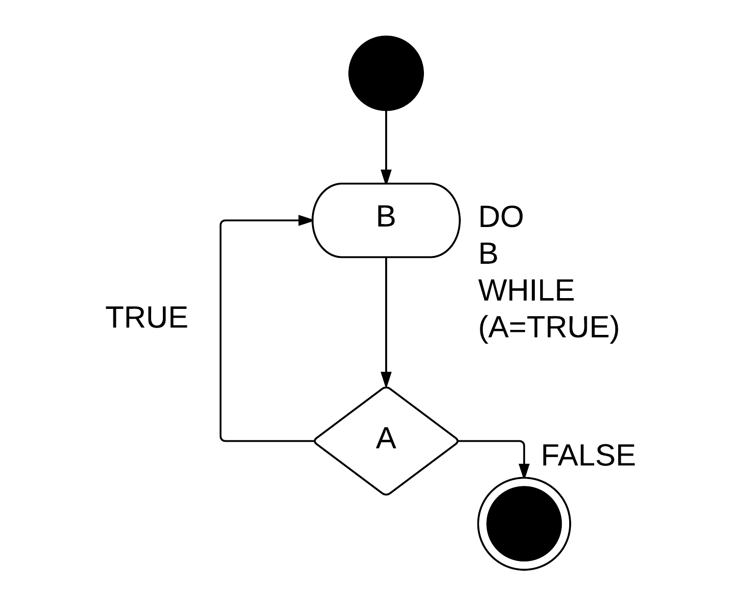
do while loop:
This is almost same as while loop, only difference is that it executes the code block at least once, even if the the condition is false.
do {
//This will be executed at least once
} while (condition);

Slide 54
Functions
A functions is named block of code which is executed when the function is called using its name.
There are some predefined functions which we will discuss shortly. We can define our own functions. Values can be passed inside functions using parameters.
type functionName(parameters) {
//code to be executed when this function is called
/* we need to return something here which has the same type as our
function */
}

Slide 55
Example:
int simpleAdder(int x, int y) {
int result;
result = x + y;
return result;
}
int a = 20;
int b = 30;
int c = simpleAdder(a, b); //c becomes 50
If you try returning a value that does not match the type of function, program will give an error.

Slide 56
Code Structure
The basic structure of Arduino programming language consists of two required functions loop and setup.
void setup() {
//code that will only once
}
void loop() {
//this contains the bulk of program and runs consecutively
//till the program is stopped
}

Slide 57
setup()
The setup() function is called only once when the program starts.
It is used to initialize pin modes or begin serial, we will cover them shortly.
This should be included in program even if there are not statements to put here
loop()
It starts after the setup() function. It does what its name says.
It loops consecutively till the program is stopped.
It contains our entire program. In here we call also call our own defined functions.

Slide 58
Arduino Specific Functions
There are some special functions used in Arduino. They are used to take input and give output through pins.
We don’t need to understand there inner working here. Our scope is limited to how can we use them.
We will discuss them one by one.
There are also a couple of keywords to define input and output.
HIGH - It simply means ON, 1 in binary, 5 volts in terms of voltage
LOW - means OFF, 0 in binary, 0 volts in terms of voltage

Slide 59
pinMode(pin, mode)
Used inside void setup() to configure a pin for either INPUT or OUTPUT.
pinMode(pin, OUTPUT); //pin is an integer variable
digitalRead(pin)
Reads the value from a specific digital pin as either HIGH(ON) or LOW(OFF)
value = digitalRead(pin) //reads the value from ‘pin’ and assigns to
//variable ‘value’

Slide 60
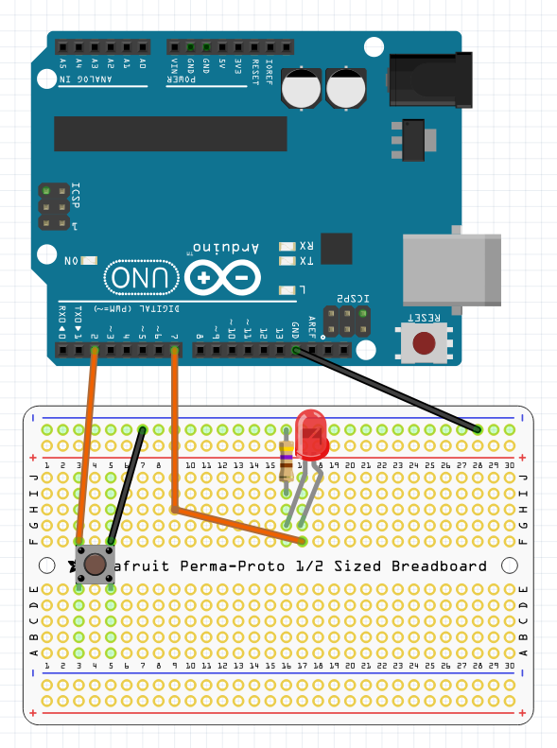
digitalWrite(pin, value)
Used to write value(HIGH or LOW) to a pin.
digitalWrite(pin, value); //writes the value ‘value’ to ‘pin’
It is also worth noting that pins configured OUTPUT and value HIGH can provide current up to 40 mA, which is enough for powering an led.

Slide 61
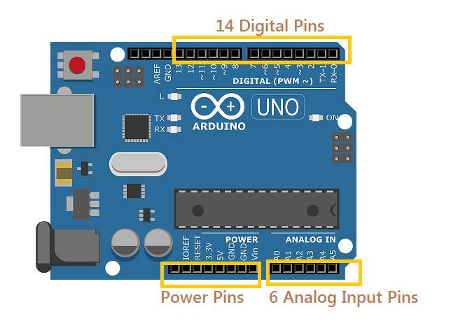
analogRead(pin)
It can read a value from an analog pin with a 10-bit resolution.
This function can only be used with pins 0 to 5.
value = analogRead(pin) //value can range from 0 to 1023
analogWrite(pin, value)
It can write an analog value(ranging from 0-255) on a pin. On newer arduinos, this function can work on pins 3, 5, 6, 9, 10, 11 and on older, it works on pins 9, 10, 11.

Slide 62
delay(ms)
Delays or pauses the program for amount of time provided in milliseconds.
millis()
Returns the time since program is running in milliseconds as ‘long’ type.
min(x, y)
Used to find the minimum of two numbers, passed in as parameters.
max(x, y)
Used to find the maximum of two numbers.

Slide 63
random(min, max)
This function allows us to get a random number
between min and max. If min is not passed, it is assumed 0.
int value = random(0, 100) //value becomes a number between 0 - 100
int value = random(100) //same thing as above
randomSeed(value)
To generate a random number the program has to generate a sequence. randomSeed(value) is used to set a starting point for that sequence generation.
You don’t have to understand it deeply.

Slide 64
Serial.begin(rate)
It opens serial port and sets up a baud rate for data transmission.
A typical baud rate for communicating with computer is 9600
It is required when need to communicate with a device using Universal Serial Bus(USB).
Serial.println(data)
It is used to print any data in the console of the device which is connected through USB.
It requires Serial.begin(rate) to be executed in order to work.

Slide 65

TinkerCAD

Slide 66
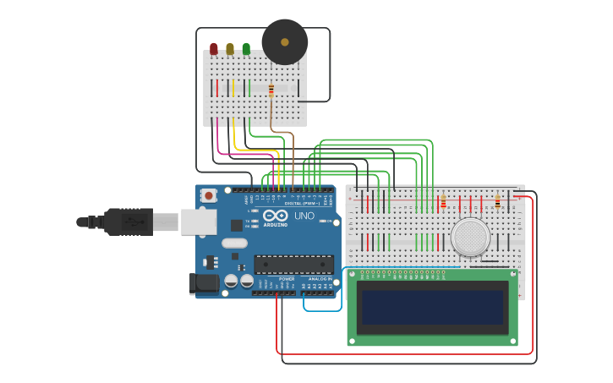
Tinkercad
Tinkercad - https://www.tinkercad.com is an excellent tool that allows you to simulate Arduino-based systems (and a lot more). You can (perhaps you SHOULD) simulate all exercises and even your own designs before trying them on real hardware. It also allows you to do programming using blocks. You can download / copy-paste the generated code later into Arduino IDE to program the real Arduino board, rather than having to write it from scratch.
Tinkercad is a free-of-charge, online 3D modeling program that runs in a web browser.
Illustration of Arduino in tinkercad

Slide 67

Team Vision Signing off

